Slide 1

Port of Wilmington
Welcomes
&
September 9, 2003

Slide 2
Port of Wilmington
A Tested & Proven Partner in Handling Specialized Cargoes

Slide 3
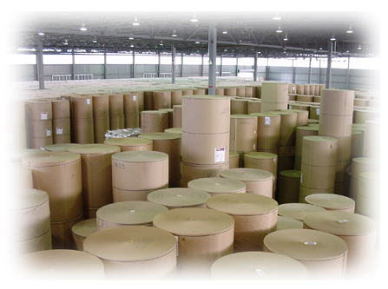
Wilmington’s Competitive Advantages
IT Expertise
Warehouse and Cargo Handling Overview
Our Swedish Connection
Summary

Slide 4
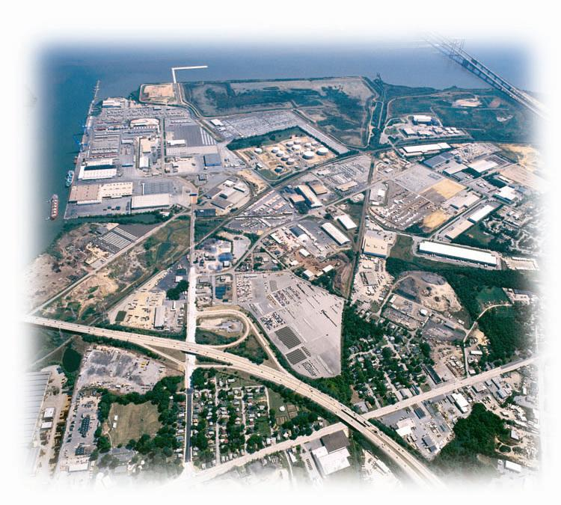
Wilmington’s Competitive Advantages
Quick, Cost Competitive Port Operations
Superior Distribution Hub
Delaware – A Great Place to Do Business
Sophisticated Security

Slide 5
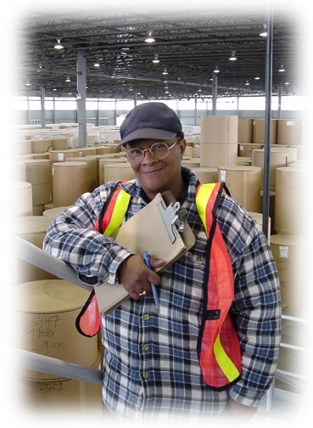
Wilmington’s Competitive Advantages
Quick, Cost Competitive Port Operations
  Efficient & Productive Labor
  Flexible Starting Times
  24/7 Discharge
  10 Hour “Straight Time”
  Multiple Gangs Available
  7 Deep-Water General Cargo Berths
  2 x 50 Ton Multi-Purpose Gantries
  1 x 100 Ton Heavy Lift
  4 Hours from the Atlantic Ocean
  5-6 Hours Savings in Ship Operating Time
  Tug & Docking Pilot

Slide 6
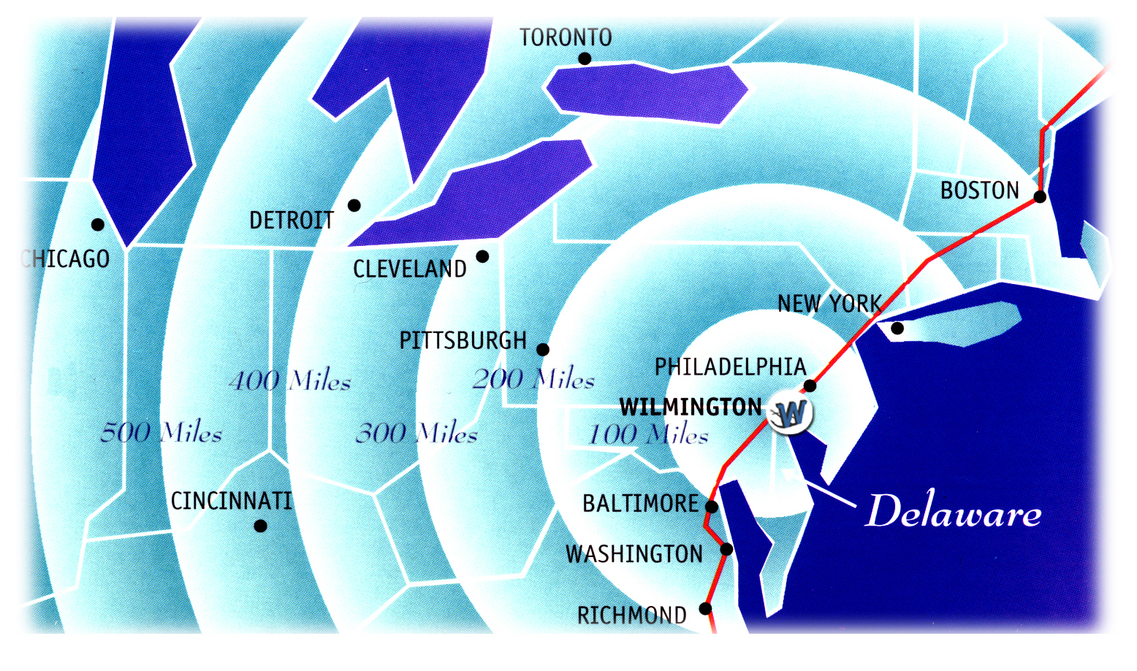
Wilmington’s Competitive Advantages
Superior Distribution Hub
  Center of US Mid-Atlantic Region
  1/3 of US Market Accessible Overnight
  Served by Norfolk Southern & CSX
    60 ft. High Cube Rail Cars
    3 Days to Lancaster
    Shellpot Bridge
  Excellent Interstate
  Highway and Rail Access

Slide 7
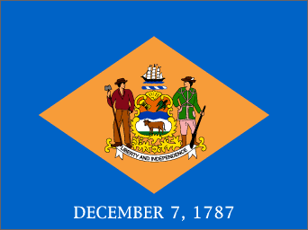
Wilmington’s Competitive Advantages
Delaware – A Great Place to Do Business
  The Port of Wilmington is Owned by the State of Delaware and Operated by the Diamond State Port Corporation
  Since 1996, the State of Delaware has Allocated
  Over $100m to Port Development and Expansion
  Delaware Governor and Congressional
  Delegation Closely Involved With Port
  Activities & Supports New Business
  Development
  4 DSPC Board Members Serve in
  State Government Cabinet-Level Positions

Slide 8
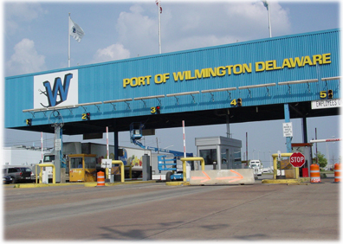
Wilmington’s Competitive Advantages
Sophisticated Security
  TWIC Card East Coast Pilot Hub
  Access Controlled Employee Entry
  In-house 24/7 Security Force

Slide 9
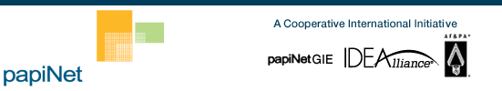
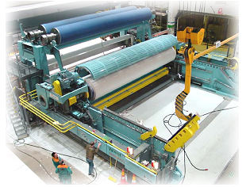
A Leader in IT Expertise
  Holmen Update
    Delivery Details: Björn Jonsson-Dannetun
    Papinet Specs
    EPC Messenger – EDI Server
    Ponton Consulting

Slide 10
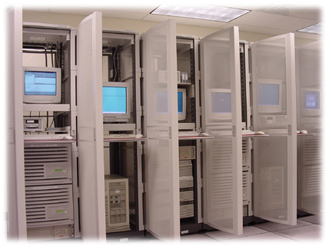
A Leader in IT Expertise
IT Services
  EDI
  Radio-Frequency Barcode Scanning
  24x7 Data Center
  T1, Fiber & Radio
  Eportwilmington.com

Slide 11
A Leader in IT Expertise
IT Projects
  VW, Dole, Chiquita
  Transportation
  GPS
  Software Development

Slide 12
Warehouse & Cargo Handling
Warehouse Facilities & Experience
Material Handling Equipment
Movement of Cargo

Slide 13
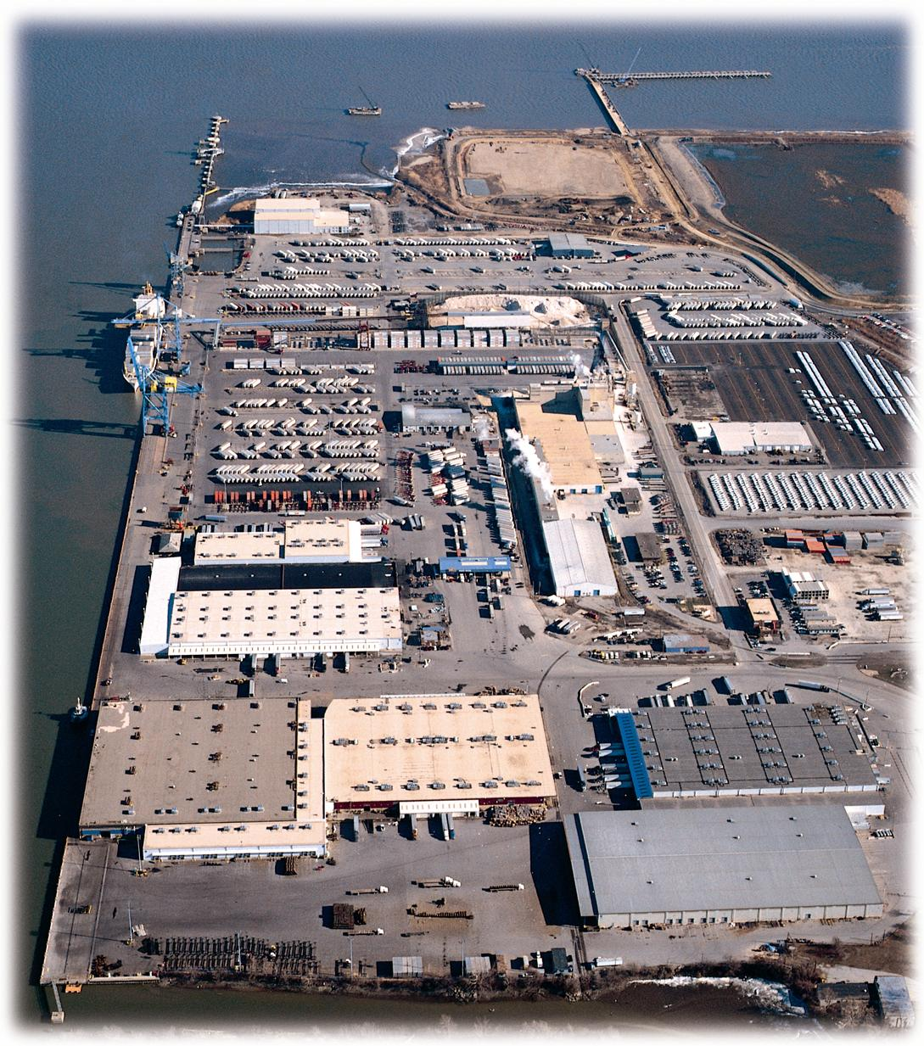
Warehouse & Cargo Handling
Warehouse Facilities & Experience
  2 Dock-Side Dry Warehouses (98,000 sq. ft. & 150,000 sq. ft.)
  Covered Warehouse Rail Service

Slide 14
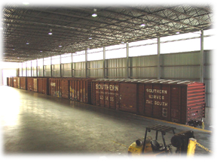
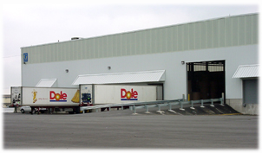
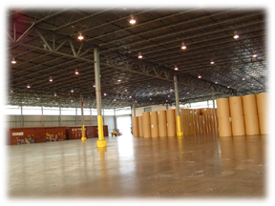
Warehouse & Cargo Handling
Warehouse G
  98,000 sq. ft. Dock-Side Dry Warehouse
  Indoor Rail – 5 Cars
  New Construction
  14 Loading Doors

Slide 15
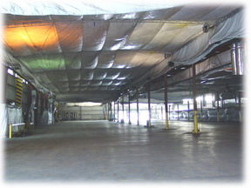
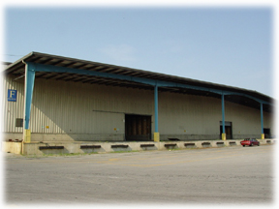
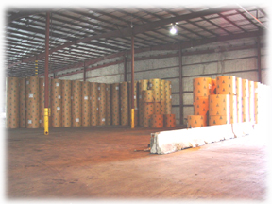
Warehouse & Cargo Handling
Warehouse F
  150,000 sq. ft.
  Covered Rail Access
  Dual Rail – Pass Thru Loading
  14 Truck Loading Doors
  Adjacent to Berth 7

Slide 16
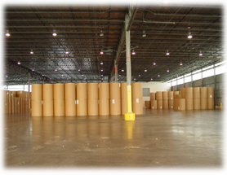
Warehouse & Cargo Handling
Warehouse Facilities & Experience
  Certified forklift operators
  KLB & Newsprint Warehousing
  “Know-How”
    Dole, Chiquita & Bertling
    > 60,000 Tons/Year – No Claims
  Experienced in Trailer & Railcar Loading & Stripping

Slide 17
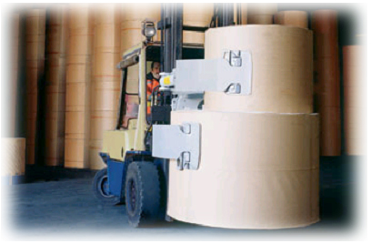
Warehouse & Cargo Handling
Material Handling Equipment
  The Port will Obtain 8-10 X 8k/12k Counterbalanced Lift Trucks with Pressure Controlled Paper Roll Clamps to Support the Holmen Paper Operation

Slide 18
Warehouse & Cargo Handling
Material Handling Equipment
  In addition…
    10 x 40’ Flat-Bed Trailers
    Additional Trailers Available on
    “On-Call” Basis
    In-House Maintenance Department
    with Qualified Diesel, Electric and
    Hydraulic Mechanics

Slide 19
Warehouse & Cargo Handling
Movement of Cargo
  Vessel Berth at Either Berth 7 or 5 ½ Dependant on Berth Availability & Warehouse Cargoes are Destined
  From Vessel Directly to Flat-Bed Trucks
  Flat-Beds to Either Warehouse F or G
  Flat-Beds Offloaded by Clamp Trucks, Sorted and Staged as Appropriate
  Truck and Rail Car Loading as Requested and Scheduled by Customer
  Customer Service Representatives Coordinate with Railroad, Customer and Terminal Service Manager Daily Hires to Accomplish Loading

Slide 20
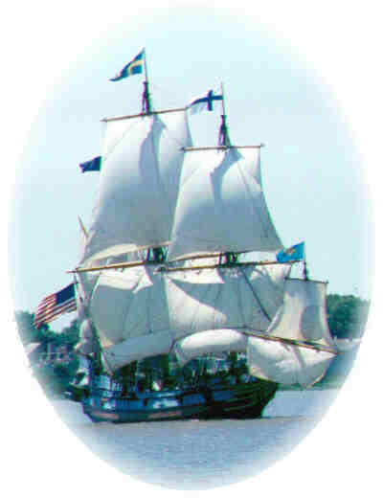
Our Swedish Connection
Swedish settlers onboard the tall ship Kalmar Nyckel arrived at Delaware in 1638 and created the first settlements in New Castle and Wilmington
A monument at the Port of Wilmington marks the location where the first settlers landed
Kalmar, Sweden is Wilmington, Delaware’s Sister City since 1963

Slide 21
Port of Wilmington
Unsurpassed In Ability to Handle
Fragile High-Value Cargo

Slide 22
Summary
Facilities
Cargo Handling Expertise
Equipment
Transportation Infrastructure

Slide 23
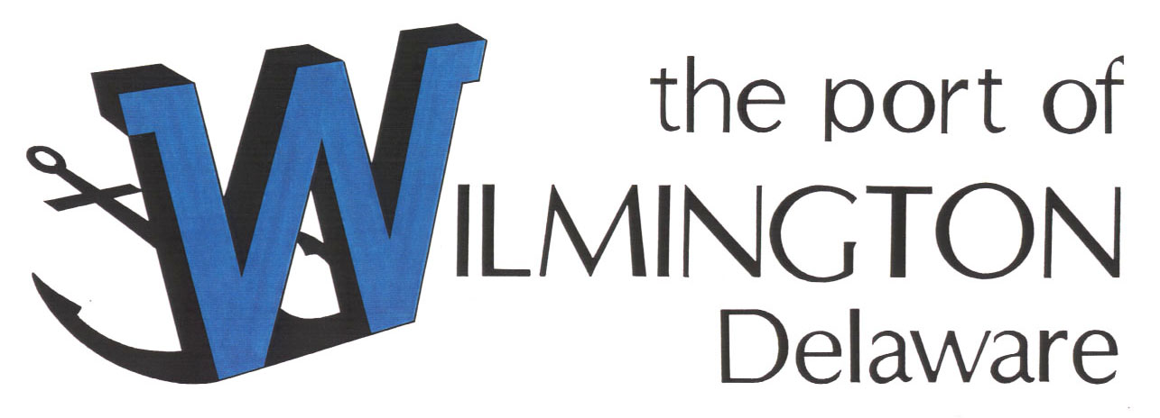
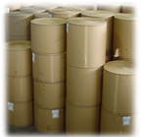
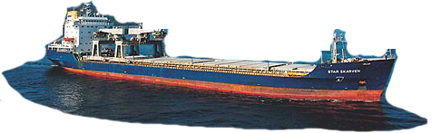
The Next Step

